Slide 1
Figures – Chapter 12

Slide 2

Figure 12.1 Risk-driven specification

Slide 3
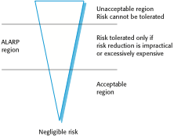
Figure 12.2 The risk triangle

Slide 4
Figure 12.3 Risk classification for the insulin pump
Identified hazard | Hazard probability | Accident severity | Estimated risk | Acceptability
1.Insulin overdose computation | Medium | High | High | Intolerable
2. Insulin underdose computation | Medium | Low | Low | Acceptable
3. Failure of hardware monitoring system | Medium | Medium | Low | ALARP
4. Power failure | High | Low | Low | Acceptable
5. Machine incorrectly fitted | High | High | High | Intolerable
6. Machine breaks in patient | Low | High | Medium | ALARP
7. Machine causes infection | Medium | Medium | Medium | ALARP
8. Electrical interference | Low | High | Medium | ALARP
9. Allergic reaction | Low | Low | Low | Acceptable

Slide 5
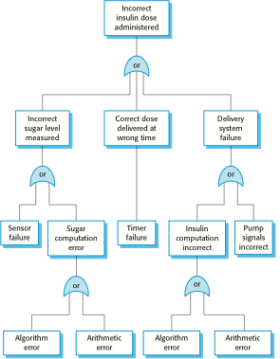
Figure 12.4 An example of a fault tree

Slide 6
Figure 12.5 Examples of safety requirements
SR1: The system shall not deliver a single dose of insulin that is greater than a specified maximum dose for a system user.
SR2: The system shall not deliver a daily cumulative dose of insulin that is greater than a specified maximum daily dose for a system user.
SR3: The system shall include a hardware diagnostic facility that shall be executed at least four times per hour.
SR4: The system shall include an exception handler for all of the exceptions that are identified in Table 3.
SR5: The audible alarm shall be sounded when any hardware or software anomaly is discovered and a diagnostic message, as defined in Table 4, shall be displayed.
SR6: In the event of an alarm, insulin delivery shall be suspended until the user has reset the system and cleared the alarm.

Slide 7
Figure 12.6 Types of system failure
Failure type | Description
Loss of service | The system is unavailable and cannot deliver its services to users. You may separate this into loss of critical services and loss of non-critical services, where the consequences of a failure in non-critical services are less than the consequences of critical service failure.
Incorrect service delivery | The system does not deliver a service correctly to users. Again, this may be specified in terms of minor and major errors or errors in the delivery of critical and non-critical services.
System/data corruption | The failure of the system causes damage to the system itself or its data. This will usually but not necessarily be in conjunction with other types of failures.

Slide 8
Figure 12.7 Availability specification
Availability | Explanation
0.9 | The system is available for 90% of the time. This means that, in a 24-hour period (1,440 minutes), the system will be unavailable for 144 minutes.
0.99 | In a 24-hour period, the system is unavailable for 14.4 minutes.
0.999 | The system is unavailable for 84 seconds in a 24-hour period.
0.9999 | The system is unavailable for 8.4 seconds in a 24-hour period. Roughly, one minute per week.</TB>

Slide 9
Figure 12.8 Examples of functional reliability requirements
RR1: A pre-defined range for all operator inputs shall be defined and the system shall check that all operator inputs fall within this pre-defined range. (Checking)
RR2: Copies of the patient database shall be maintained on two separate servers that are not housed in the same building. (Recovery, redundancy)
RR3: N-version programming shall be used to implement the braking control system. (Redundancy)
RR4: The system must be implemented in a safe subset of Ada and checked using static analysis. (Process)

Slide 10
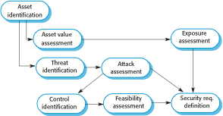
Figure 12.9 The preliminary risk assessment process for security requirements

Slide 11
Figure 12.10 Asset analysis in a preliminary risk assessment report for the MHC-PMS
Asset | Value | Exposure
The information system | High. Required to support all clinical consultations. Potentially safety-critical. | High. Financial loss as clinics may have to be canceled. Costs of restoring system. Possible patient harm if treatment cannot be prescribed.
The patient database | High. Required to support all clinical consultations. Potentially safety-critical. | High. Financial loss as clinics may have to be canceled. Costs of restoring system. Possible patient harm if treatment cannot be prescribed.
An individual patient record | Normally low although may be high for specific high-profile patients. | Low direct losses but possible loss of reputation.

Slide 12
Figure 12.11 Threat and control analysis in a preliminary risk assessment report
Threat | Probability | Control | Feasibility
Unauthorized user gains access as system manager and makes system unavailable | Low | Only allow system management from specific locations that are physically secure. | Low cost of implementation but care must be taken with key distribution and to ensure that keys are available in the event of an emergency.
Unauthorized user gains access as system user and accesses confidential information | High | Require all users to authenticate themselves using a biometric mechanism. Log all changes to patient information to track system usage. | Technically feasible but high-cost solution. Possible user resistance. Simple and transparent to implement and also supports recovery.

Slide 13
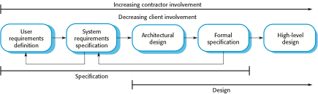
Figure 12.12 Formal specification in a plan-based software process

